Slide 1
Call to action to employers: Re-imagine refugees as employees and colleagues
Assoc. Prof. Betina Szkudlarek, University of Sydney Business School
Author of “Engaging business in refugee employment: The employers’ perspective” (Nov 2019)
AND
Selena Choo, Founder, Humans Like Us
Author of “Australian Employers’ Guide to Hiring Refugees” (Feb 2019)

Slide 2
Motivation
Low employment outcomes
Ongoing consultations with numerous stakeholders including CPD, SCOA and MCA among others
Ongoing consultations with DJSB and DSS
Ongoing research on the role of support organizations
Lack of employers’ perspective

Slide 3
Overview of data
60 survey responses to digital survey (118 total partially completed responses)
Survey responses cover broad range of employers
Respondents from organisations operating in all states and territories
29% in Human Resources, 27% at CEO/Director level, 27% in other mgmt roles
Manufacturing, Construction, Professional, Sci. & Tech. Services, Health Care
29 in-depth interviews with a broad range of companies and employment roles
15 interviews with heads of diversity/sustainability and 5 employer case studies involving at least 3 interviews each
Organisations predominantly based in NSW and VIC
Construction, Hospitality, Retail, Financial services, Government, Farming, Manufacturing

Slide 4
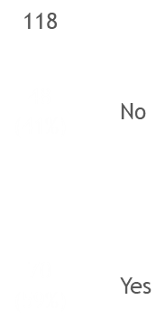
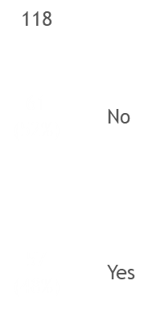
Overview Statistics
Survey included both companies that had and had not hired refugees (59% vs 41%) and those who had and had not actively sought to hire (57% vs 61%)
Has your company actively sought to employ refugees?
Distribution of companies by experience hiring
refugees and/or seeking to hire refugees
Has your company employed one or more refugees in Australia in the last 5 years?
15 companies
55 companies
Has employed one or more refugees in past 5 years
46 companies
2 companies
Has not employed one or more refugees in past 5 years
Has not actively sought to hire refugees
Has actively sought to hire refugees

Slide 5
Findings

Slide 6
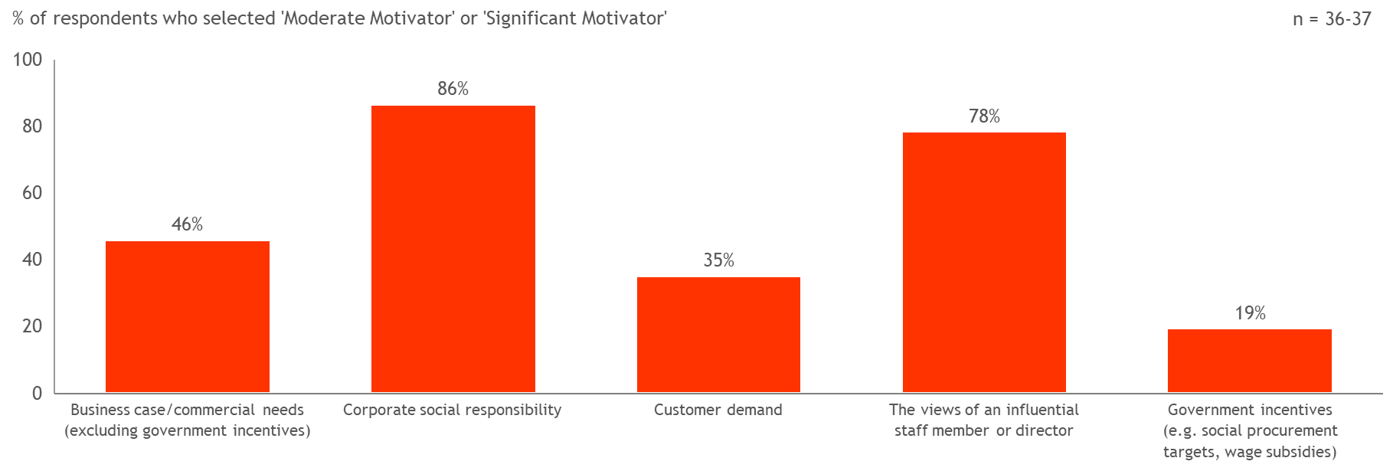
Motivators for hiring refugees
Notes:
Why do companies hire? What is the initial trigger?

Slide 7
Quotes
"It is personally rewarding and motivating to staff to know that they are making a difference in someone’s life by hiring a refugee."
“We hire refugees because we get very motivated staff that really try their best to be successful in their roles.”
“I don't think that the general Australian population realizes how many extremely qualified people are coming in.”

Slide 8
Circumstances prompting engagement
Outreach efforts from service providers
Political backing
Self-imposed targets
Over time
Leadership commitment and staff buy-in

Slide 9
92% of those who seek to employ refugees are likely or highly likely to recommend to others; productivity levels are mostly about the same or better

Slide 10
Greatest obstacles
English language proficiency
Cultural differences
Lack of Australian work experience
Additional time and resources to bring refugees up to speed
Difficulty finding refugees
Internal opposition
Unrealistic expectations from the team
Accusation of discriminatory recruitment practices

Slide 11
Benefits of hiring refugees
The perceived benefits of hiring refugees outweigh the challenges
Many employers described refugees as hardworking, committed and eager to learn
Over 90% of respondents are likely or highly likely to recommend refugee employees to others
Productivity levels are mostly the same or higher in comparison to those of local workforce

Slide 12
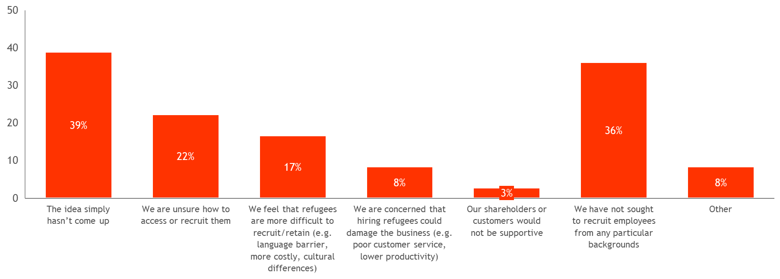
Reasons for not hiring refugees
Common reasons for not hiring are the idea not coming up, not seeking to hire from particular backgrounds & not knowing how to access or recruit refugees

Slide 13
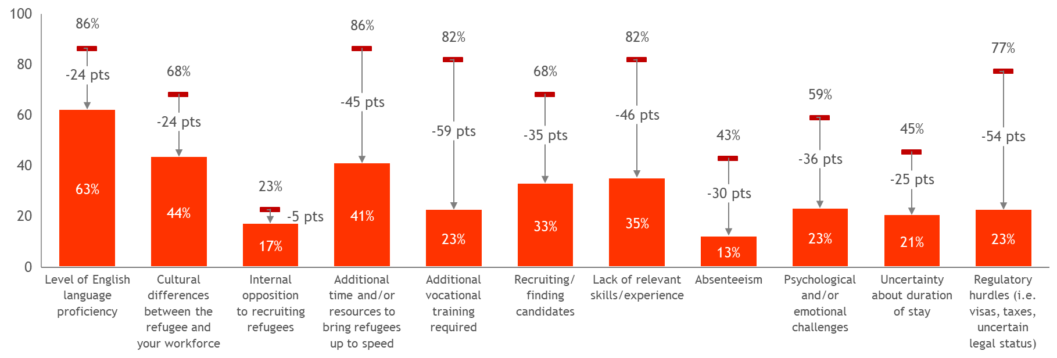
Companies that have not hired refugees rate almost all challenges to be significantly more difficult than companies that have hired refugees

Slide 14
Refugee workforce integration
First experiences can be very powerful
Successful hiring and retention requires a long-term, holistic approach, the support of influential staff members and the engagement of peers and supervisors
The perceptions of refugee workforce integration differed within organisations. HR staff and senior management were often disconnected from the reality of daily interactions and workplace integration challenges faced by refugees or possible hidden costs
The role of an inclusive workplace

Slide 15
The role of service providers
Specialist service providers played a significant and positive role
Many employers used a full suite of service provider offerings (e.g. search, culture training, resume and interview preparation, etc)
Poor quality candidate referrals were the main reason that employer collaborations with service providers were discontinued.

Slide 17
Knowledge bridge to fill an information gap
This Photo by Unknown Author is licensed under CC BY-NC

Slide 18
Empowering everyone to contribute
PURPOSE
Contribute to social cohesion by building the capacity of employers and consumers to support refugees in their working life.

Slide 19
What we do
Tell a different story about refugees
Refugees are people with agency, want to be self-sufficient and build a new life.
Contrast to popular stories: object of pity vs causing crowded cities.
Provide expert advice and access to experts
Updates on developments in the refugee situation; how other actors are contributing, current issues, emerging opportunities.
Expert, tailored advice.
Connect employers with academic, policy and community sector.
Employer Network for Refugee Inclusion
Bring employers together to learn, share, support and develop best practice for their individual companies.

Slide 22
Refugee employment services directory

Slide 23
National refugee business directory

Slide 24
Success through building and sharing collective experience
“Our greatest achievements have come about by talking, and its greatest failures by not talking…All we need to do is make sure we keep talking.”
Stephen Hawking

Slide 25
Thank you Selena Choo www.humanslikeus.org selenachoo@outlook.com Dr Betina Szkudlarek betina.szkudlarek@sydney.edu.au

